Slide 1
DC Circuits
Maximum Power Transfer Theorem
By Dr. Ahmed S. Abdullah
د. احمد سليمان عبدالله

Slide 2
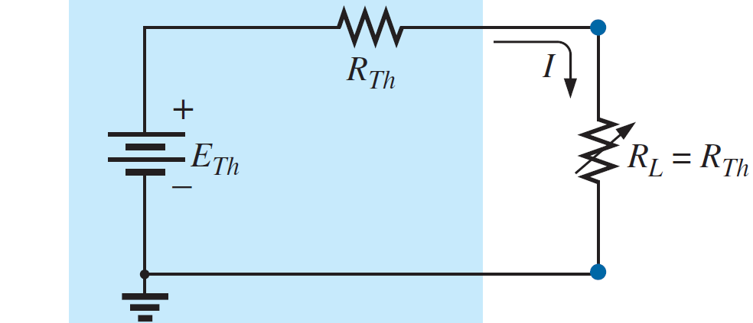
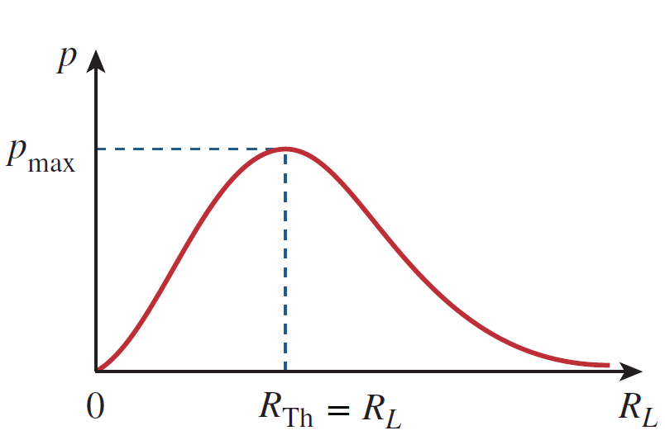
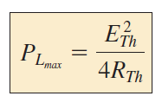
Maximum Power Transfer Theorem
Maximum power is transferred to the load when the load resistance equals the Thevenin resistance as seen from the load $(R_{L}=R_{Th})$
and

Slide 3
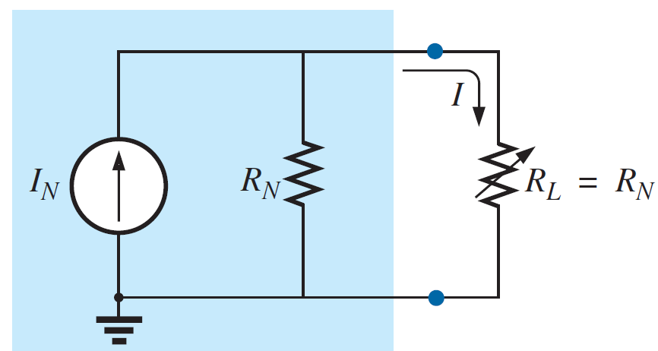
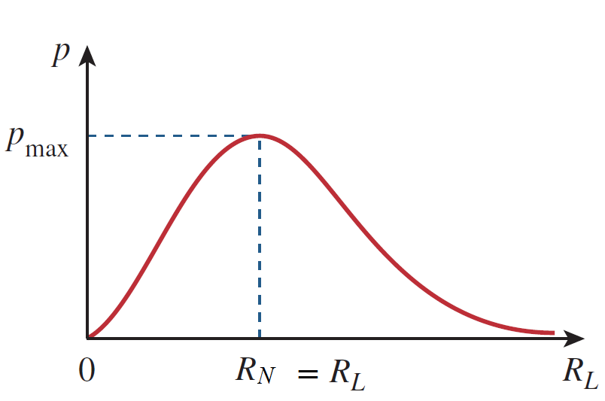
Maximum Power Transfer Theorem
Maximum power is transferred to the load when the load resistance equals the Norton’s resistance as seen from the load $(R_{L}=R_{N})$
$$I_{L}=\frac{I_{N}R_{N}}{R_{N}+R_{L}}= \frac{I_{N}R_{N}}{R_{N}+R_{N}}=\frac{I_{N}R_{N}}{{2R}_{N}}$$
$$P_{L}={I_{L}}^{2}R_{L}={I_{L}}^{2}R_{N}={\left(\frac{I_{N}R_{N}}{{2R}_{N}} \right)}^{2}R_{N}$$
and

Slide 4
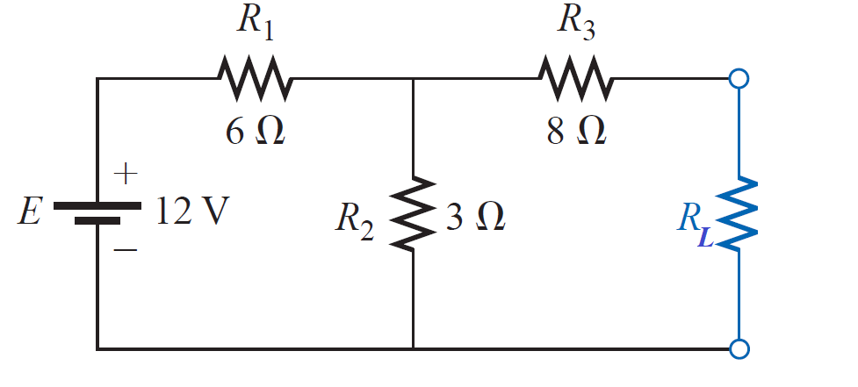
Maximum Power Transfer Theorem
EXAMPLE 1: For the network shown, determine the value of R_{L} for maximum power transfer, and calculate the maximum power delivered under these conditions.

Slide 5
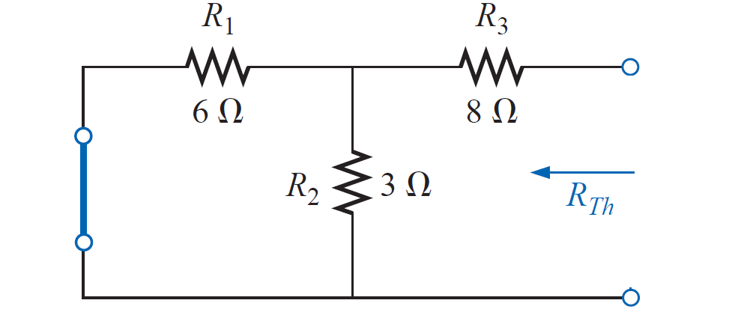
Maximum Power Transfer Theorem
EXAMPLE 1: For the network shown, determine the value of R_{L} for maximum power transfer, and calculate the maximum power delivered under these conditions.
Solution:

Slide 6
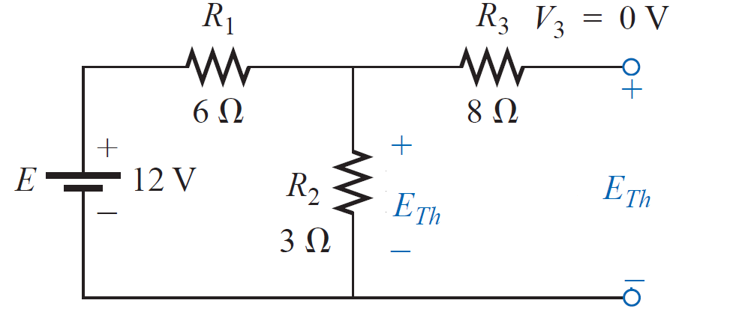
Maximum Power Transfer Theorem
EXAMPLE 1: For the network shown, determine the value of R_{L} for maximum power transfer, and calculate the maximum power delivered under these conditions.
Solution:

Slide 7
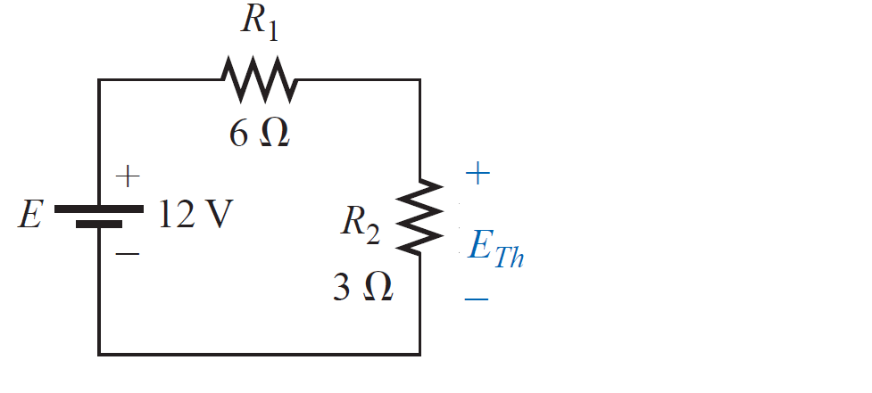
Maximum Power Transfer Theorem
EXAMPLE 1: For the network shown, determine the value of R_{L} for maximum power transfer, and calculate the maximum power delivered under these conditions.
Solution:

Slide 8
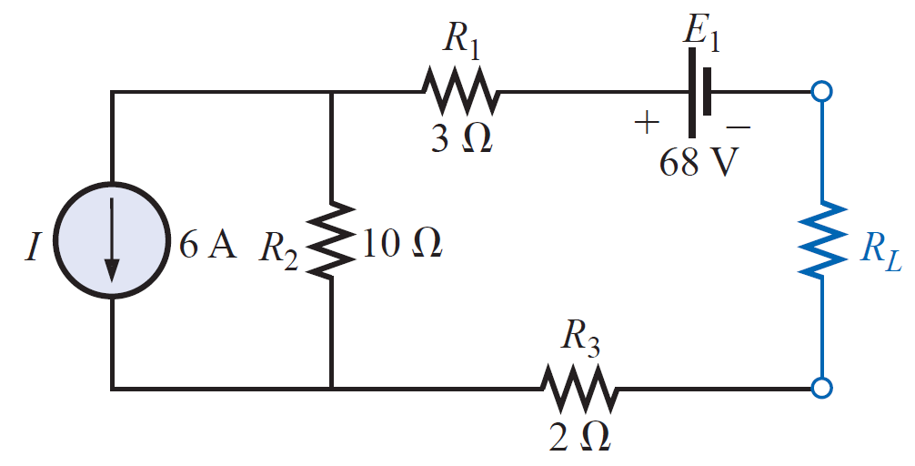
Maximum Power Transfer Theorem
EXAMPLE 2: Find the value of R_{L} in network shown for maximum power to R_{L} , and determine the maximum power.

Slide 9
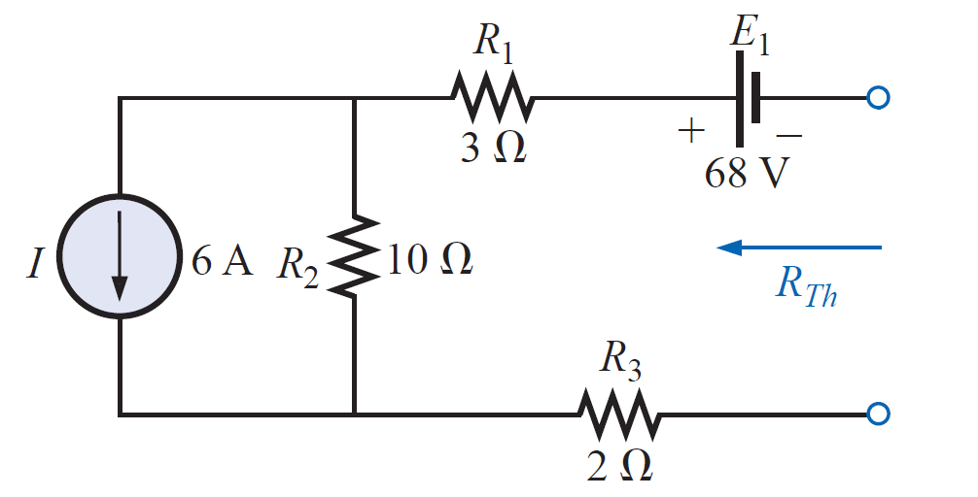
Maximum Power Transfer Theorem
EXAMPLE 2: Find the value of R_{L} in network shown for maximum power to R_{L} , and determine the maximum power.
Solution:

Slide 10
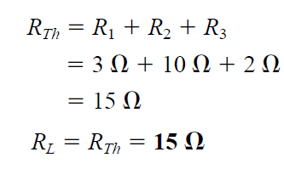
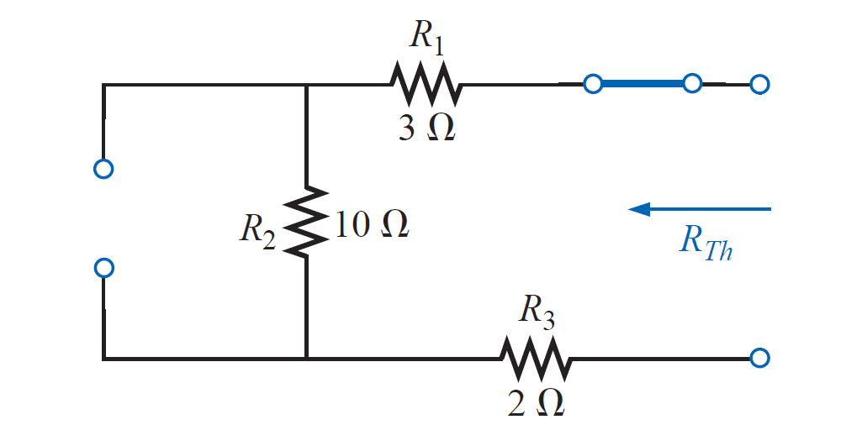
Maximum Power Transfer Theorem
EXAMPLE 2: Find the value of R_{L} in network shown for maximum power to R_{L} , and determine the maximum power.
Solution:

Slide 11
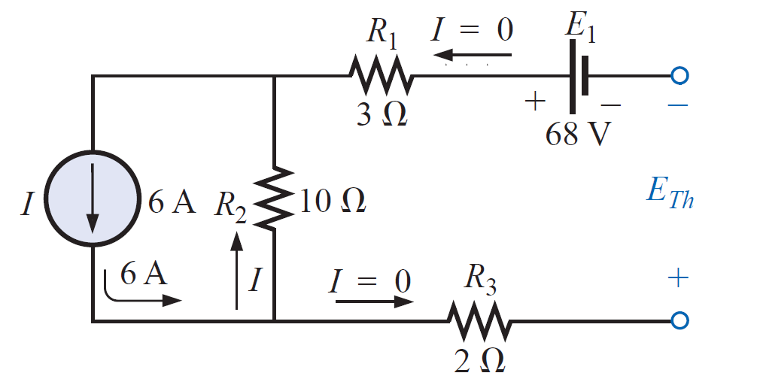
Maximum Power Transfer Theorem
EXAMPLE 2: Find the value of R_{L} in network shown for maximum power to R_{L} , and determine the maximum power.
Solution:

Slide 12
Maximum Power Transfer Theorem
EXAMPLE 2: Find the value of R_{L} in network shown for maximum power to R_{L} , and determine the maximum power.
Solution:

Slide 13
Maximum Power Transfer Theorem
EXAMPLE 2: Find the value of R_{L} in network shown for maximum power to R_{L} , and determine the maximum power.
Solution:

Slide 14
Maximum Power Transfer Theorem
EXAMPLE 2: Find the value of R_{L} in network shown for maximum power to R_{L} , and determine the maximum power.
Solution:

Slide 15
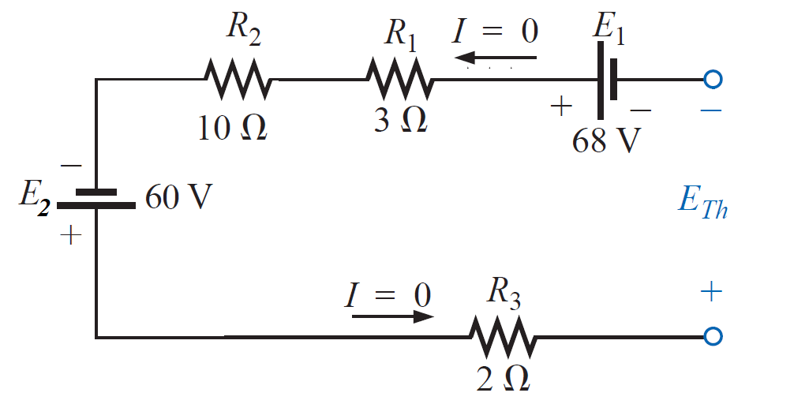
Maximum Power Transfer Theorem
EXAMPLE 2: Find the value of R_{L} in network shown for maximum power to R_{L} , and determine the maximum power.
Solution:

Slide 16
References
Boylestad, Robert L. Introductory circuit analysis. Pearson Education, 2010.
Robbins, Allan H., and Wilhelm C. Miller. Circuit analysis: Theory and practice. Cengage Learning, 2012.
Sadiku, Matthew NO, and Chales K. Alexander. Fundamentals of electric circuits. McGraw-Hill Higher Education, 2007.

